Slide 1
Lecture 8
Evaluation of Postfix Expression

Slide 2
636+5*9/-

Slide 3
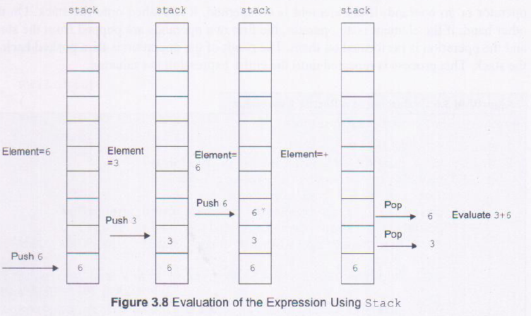
EVALUATION OF POSTFIX EXPRESSION
For example, consider the evaluation of the following postfix expression using stacks: abc+d*f/- where,
a=6, b=3, c-6, d=5, f=9 After substituting the values of a, b, c, d and f, the postfix expression becomes 636+5*9/-
The expression is evaluated as follows:

Slide 4
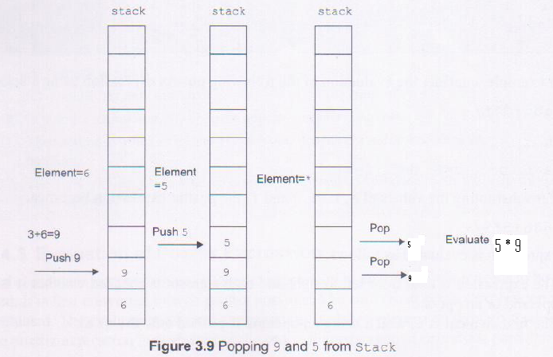

Slide 5
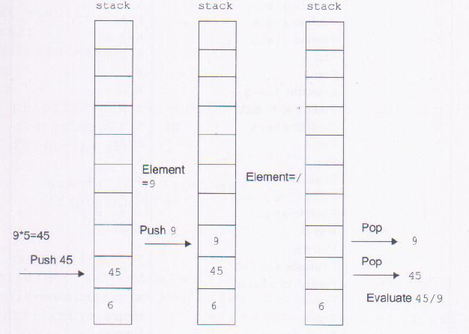
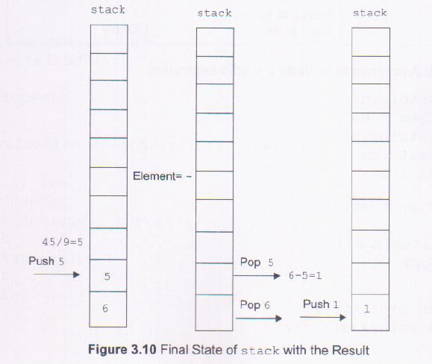

Slide 6
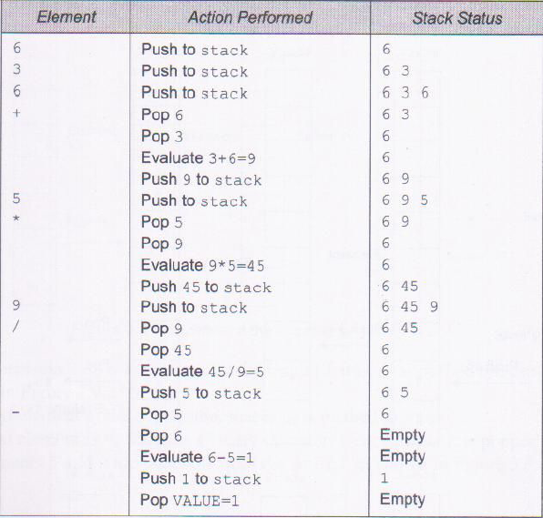
STEP WISE EVALUATION OF 636+5*9/-

Slide 7
EXAMPLE:
Evaluate Following Postfix Expression:
(1)A*B+C/D (if A=3,B=2,C=25,D=5) using stack.
(2)AB+C*D(if A=2,B=3,C=4,D=5)( assume + after D)
(3)562+*124/-
(4)ABC^/DE*+AC*-(A=27,B=3,C=2,D=3,E=17)
(5)76 + 4 * 410 - ^ 5 +
(6) 75 – 9 2 / * (ANS: 9.00)

Slide 8
End

